Slide 1
CA-RA basics
Release basics with TECO point of view
Aditya Rahatekar
Trainee
Tieto, ZST Technology Services and Modernization / ZSTEO DevOps & TECO
aditya.rahatekar@tieto.com

Slide 2
Table of contents
TECO & Its process.
What is Release & deployment of an application.
Need for the Automation.

Slide 3
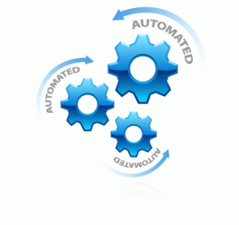


TECO and Process…

Slide 4
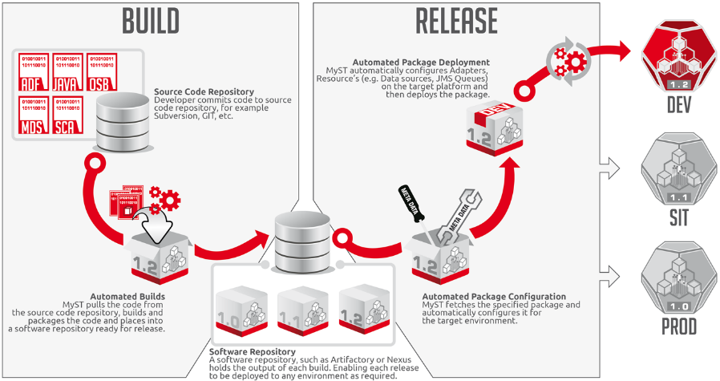
Release and deployment

Slide 5

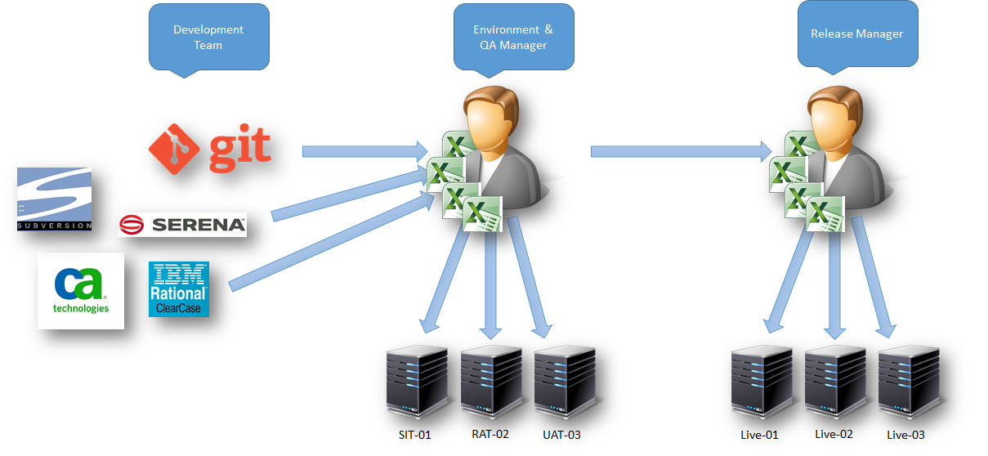
Release Automation.

Slide 6
Aditya Rahatekar
Trainee
Tieto, ZST Technology Services and Modernization / ZSTEO DevOps & TECO
aditya.rahatekar@tieto.com

